Slide 1

Threat hunting
…looking (also) outside the EDR

Slide 2
AGENDA
Intro
When do people hunt?
Setting up the (incident) scene
Let’s go hunting
Better hunting
Don’t get hunted

Slide 3


Intro

Slide 4


When do people hunt?
Answer: when they’re hungry

Slide 5
Translating this to security talk
>>> When an incident puts pressure on a company threat hunting program get a boost (or a start, depends on the case).

Slide 6

Setting up the (incident) scene
Introduction and orientation
First customer meeting (s)

Slide 7
(a)Typical scenario for a security incident
all (security related) logs in SIEM
correlations in place
EDR licensed and updated to include full command line logging and relevant intel
…so, we can start hunting and solve our incident!

Slide 8

Isn’t it?
Did this ever happen to you?
(or outside let’s say if you work for the top X banks in the country)

Slide 9

One should be happy if
There IS a SIEM
There IS an EDR
The SIEM has default correlations in place and has a minima of sources like EDR alerts, firewall logs

Slide 10

Typical dreams crushers
The SIEM correlations have never been reviewed, improved or customized with one’s business needs
Quite some security logs are not (yet) in the SIEM (costs/ in-out clouds, not knowing all sources producing security logs/ shadow IT/ costs / volumes, costs/efforts in formatting and processing logs)
The EDR is so basic that it sounds more like an AV from the 90’s

Slide 11

Towel reasoning:
you might need to spend some time on the incident / bring emergency bag.

Slide 12
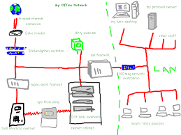
First meeting:
Make sure you get access to the right contacts
Make sure you get access to the logging in place
When something is not clear : ASK QUESTIONS!!!
Make sure you get the overview picture or design

Slide 13
AND DON’T FORGET…
WHEN SOMETHING IS NOT CLEAR

Slide 14

Let’s see an example …

Slide 15
What is this large data transfer?
You see this in flow logs, firewall logs, storage logs
Most flows nowadays are TCP 443
Maybe a legit app usage or backup
Maybe a 3rd party business function
What if large transfer on port 80?
You will not see this in the EDR logs…

Slide 16
What about Jim in sales? What about Joel in HR? What do you think they have in common?

Slide 17


Slide 18

The wonders of shadow IT ! … yet another TCP 443 flow
Jim and Joel bought these cloud services to make their work easier
They paid with own cc to speed up things and just declared costs
No business impact analysis on what data goes up and down? (data classification much?)
They agreed to the big popup informing them that data will be kept in this cloud service for an X amount of time
They didn’t setup MFA because … well, too much effort
They got an admin panel with security logs,
but no one asked them
to import these logs in the SIEM (why?)
It will be a true adventure to correlate the large data flow we were speaking about to these services and their owners within customer realm

Slide 19

What do you do as a security incident investigator?
Add new information to your overall picture
Record the moments in time when these new findings took place (use UTC!!!)
Try to get access to review new security relevant logs when a new source has been identified
Include in your note when did you get access to these new category of logs
If very dangerous findings think of next steps (known full cloud compromise / security incident log located/ no MFA/ etc)

Slide 20

Which one is the best tool to record your finding?
Whatever works for you, but this one work very well and it’s free: Timeline explorer
https://ericzimmerman.github.io/#!index.md

Slide 21

UTC!!!
Why I keep pushing this?

Slide 22

Let’s go hunting
… add a bit of time pressure as we are facing a live incident

Slide 23
BACK to our siem

Slide 24
Few things to keep in mind
There is a delay between live events and the SIEM log arrival (most cloud tooling has these delays published)
SIEM will have less logs than the EDR for an endpoint, but it can point you in the right direction
You still need to go to the EDR logs for more details, features, digging
If firewall logs are too costly, try a small selection first: outgoing for example (what do you think it’s more interesting: outgoing dropped or outgoing allowed?)
If no EDR you will need to check (with the help of an admin) windows/ linux server logs – and hope, there is a central logging repository

Slide 25

Best way to know an environment is to run your hunts
Command history
Scheduled tasks
Encoded PS
PS downloads
New accounts
Recon commands from LOCAL SYSTEM (netstat/whoami/at…)
New services
New scheduled tasks
RDP using high privileged accounts
Processes started from the recycle bin ….
Not all the things are bad, but at least we know who/what they are

Slide 26
Syntax
… it is important to know what you are looking for/ local admin will help you get it (and if not google and experience after a while)

Slide 27

EDR logs are an excellent hunting ground but it can become an addiction – don’t panic when it’s not there.

Slide 28
Few other hunts ideas
Create statistic hunts: top rare present process names, stats and counts on used wmi commands, top and count for 1-2 chars file names
Event logs being cleared ("Microsoft-Windows-Eventlog“,1102 or 517/ "PowerShell log file was cleared“, 104/ "System log file was cleared“, 104)
Hidden files, hidden shares (\$)
RDP successful login stats (logon type 10/ 4624 or 528)
Statistics on overall file extensions and counts (interesting if encrypted/ atypical extensions or misspelled extensions are found)

Slide 29

Limitations -
and need for correlations
What about that critical alert about a connection out to a C2, identified by the EDR intel?
Did the C2 contact really took place?
Don’t forget: (if) EDR runs ON a host, it won’t go trace your packet in the network!!!

Slide 30

Do you have proxy logs to correlate?
Do you have firewall logs to correlate? (remember: which outgoing firewall logs are the most interesting?)
Do we have intel feeds on all these devices?
Are they DIFFERENT feeds with DIFFERENT (quality of) intel?

Slide 31
Question:
Considering the traffic path: infected host, process starts, trying to connect out to a C2.
Where is the most logical next step to have the layered approach to terminate this flow in path towards the C2? (in most cases EDR will allow a process to run first few seconds, or, if unknown as bad yet, for a longer amount of time)

Slide 32

Host trying to connect out to some_bad_place_running_malware.ru …

Slide 33

Ideally traffic should be blocked as close to the source as possible
Before leaving the enterprise domain/ infra setup
SOOOOOO….
Ideally block right at DNS lookup/ DNS server
OR
The latest at proxy or boundary firewall
OR

Slide 34

How often did you encounter a DNS server using intel feeds? (being able to and using)

Slide 35

Better hunting
There are a lot of potential improvements for the hunting processes which can be suggested after solving an incident
Not many IR teams consider security improvements as an IR step

Slide 36
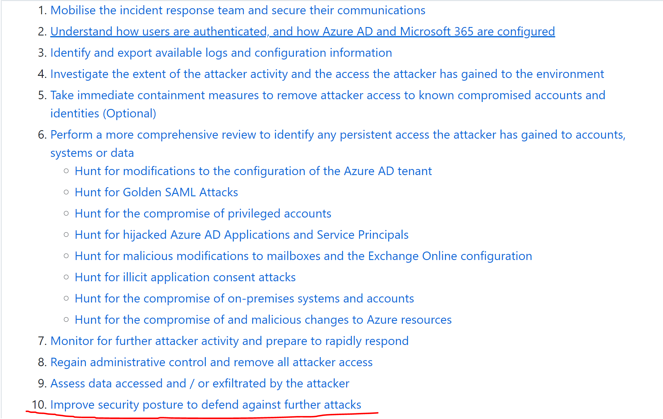
One such very brave example: https://github.com/WillOram/AzureAD-incident-response

Slide 37

Worth considering
One major improvement for a lot of organizations in building an intel sharing automation or using an intel sharing platform to process all the feeds they buy from different sources

Slide 38

Many even buy the same intel TWICE !!!
Advice: investigate before you decide to buy an intel feed (EXPENSIVE!!!) for overlap with intel you already use and plan to use the intel in every project able to consume.

Slide 39

Also… SEGMENTATION!
You can buy a top-of-the-line EDR, click on a spear phishing and still face risks if every project you are running runs happily together in vlan 1.

Slide 40
Quick win!
Consider blocking all domains which are newer than few weeks (1 – 4 weeks, most common choices)
Feature present in many proxy and firewall tooling: USE IT!!!
You can always exclude own and 3rd parties' domains and subdomains.

Slide 41
Question:
Which one is the best intel you can have?

Slide 42
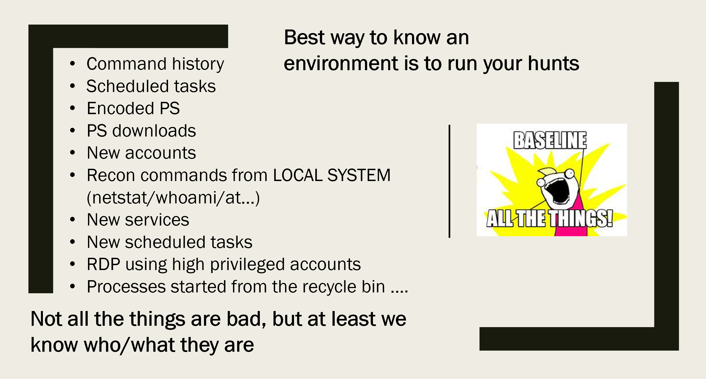
Remember this slide?
Well, this is intel which is created in your own context.
This is the non degraded by time or external setup.

Slide 43
BONUS!
The SOC can use the hunts to create alerts once the query is adapted to identify the outliners
It should be a process where hunting feeds SOC intel for their alerts even outside an incident situation

Slide 44


Don’t get hunted
Don’t forget smart adversaries ALSO hunt during incidents (aka they might setup automations to alert on security response activities)
Beware of where from you run your hunts, under what account, what queries and where the results get stored – so the intruder doesn’t notice your activities, or even worse … starts influencing your results

